Slide 1
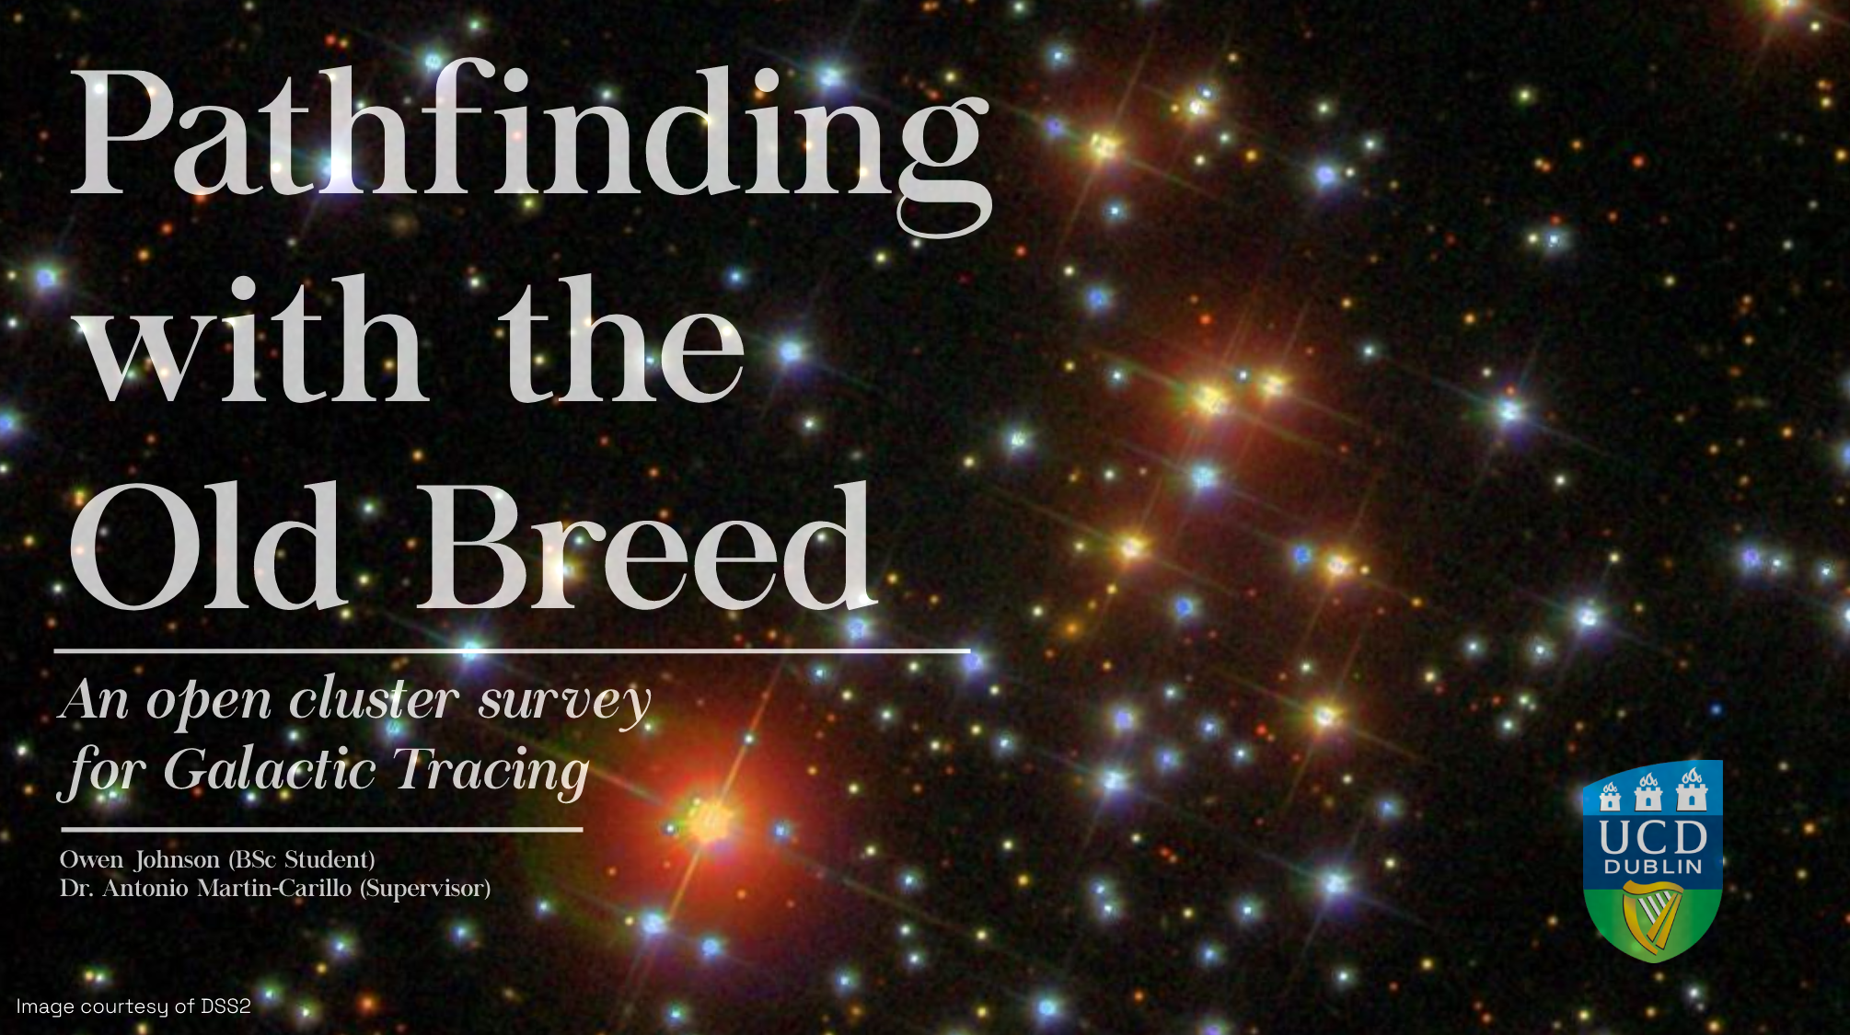

Slide 2
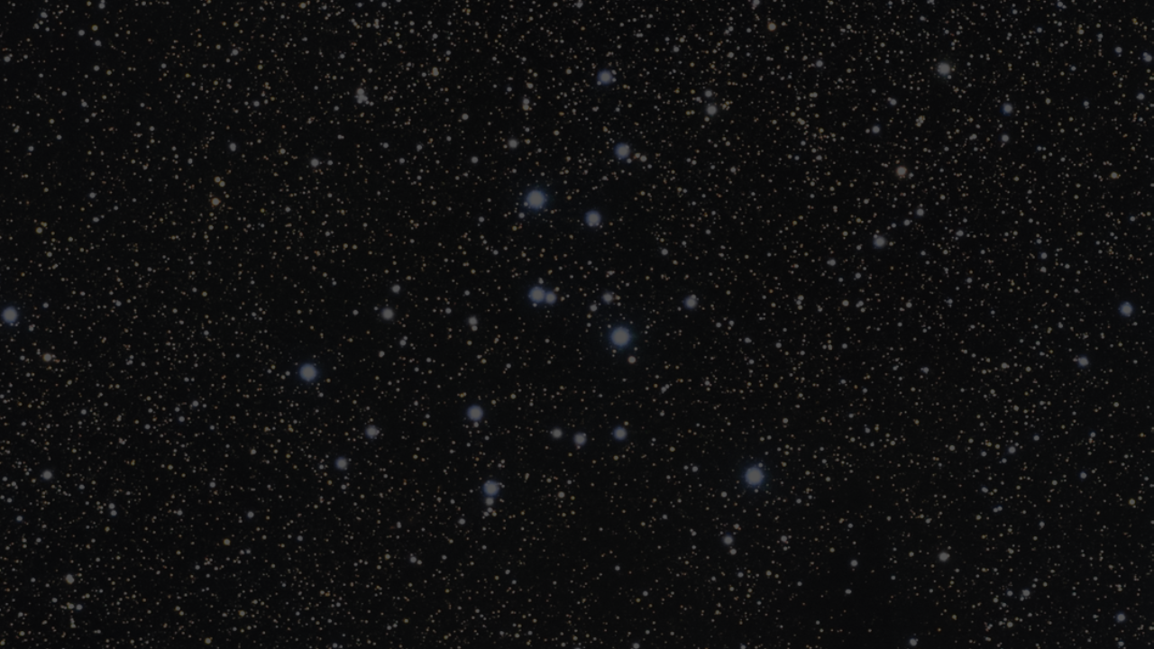
“The heavens are now seen to resemble a luxuriant garden, which contains the greatest variety of productions, in different flourishing beds.”
- Sir William Herschel

Slide 3

Objectives and Motivation
Primary Objective
Observe open cluster with little use in galactic tracing
Determine cluster’s population using methods from modern studies and algorithms
Explore relationships between parameters and Galactic position.
Secondary Objective
Classify observed clusters according to the Trumpler scheme
Nicely catalog stellar population of each
Motivation
Lots of data, no one to analyze.
Large development in isochrone research in the last 2 decades
Aid Gaia’s second data release (GDR2)
Resurgence of similar studies [Xiang, M., Rix, HW. (2022)]

Slide 4
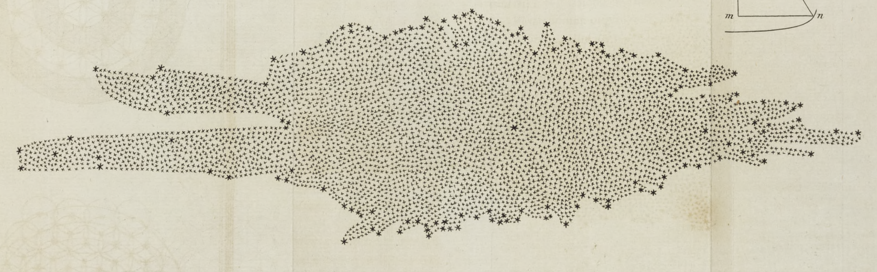
A Brief History on Galactic Tracing and Open Clusters
1785: William Herschel publishes ‘on the construction of the heavens’ detailing one of the first formal mappings of the milky way
1918 – 1930: Harlow Shapley & Robert Trumpler use classification schemes and cluster parameters to try relate milky way structure.
1960 – 90’s: Van de Burgh, Becker and Fenkart conduct first studies mapping the arms of the milky way using open clusters.
1980’s – 2010’s: Lynga and Janes
et al. perform mass isochrone fitting
and cataloging.
2010’s – Present: Dozens of ML
and statistical studies querying 1000’s of clusters

Slide 5
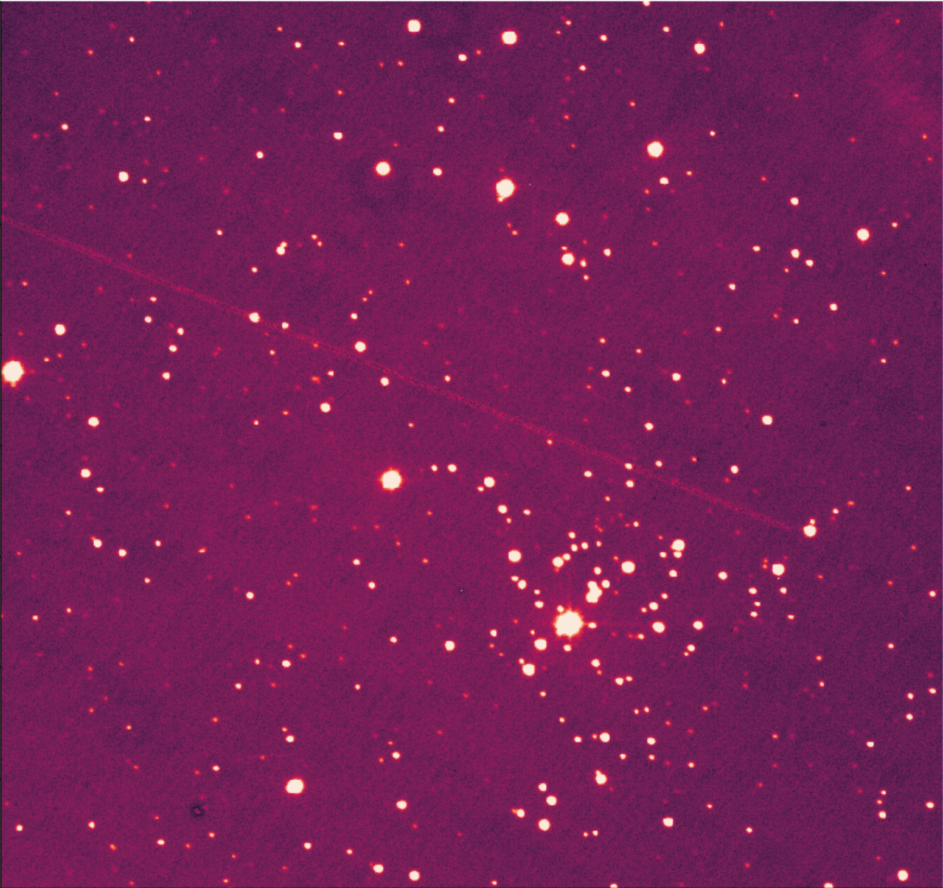
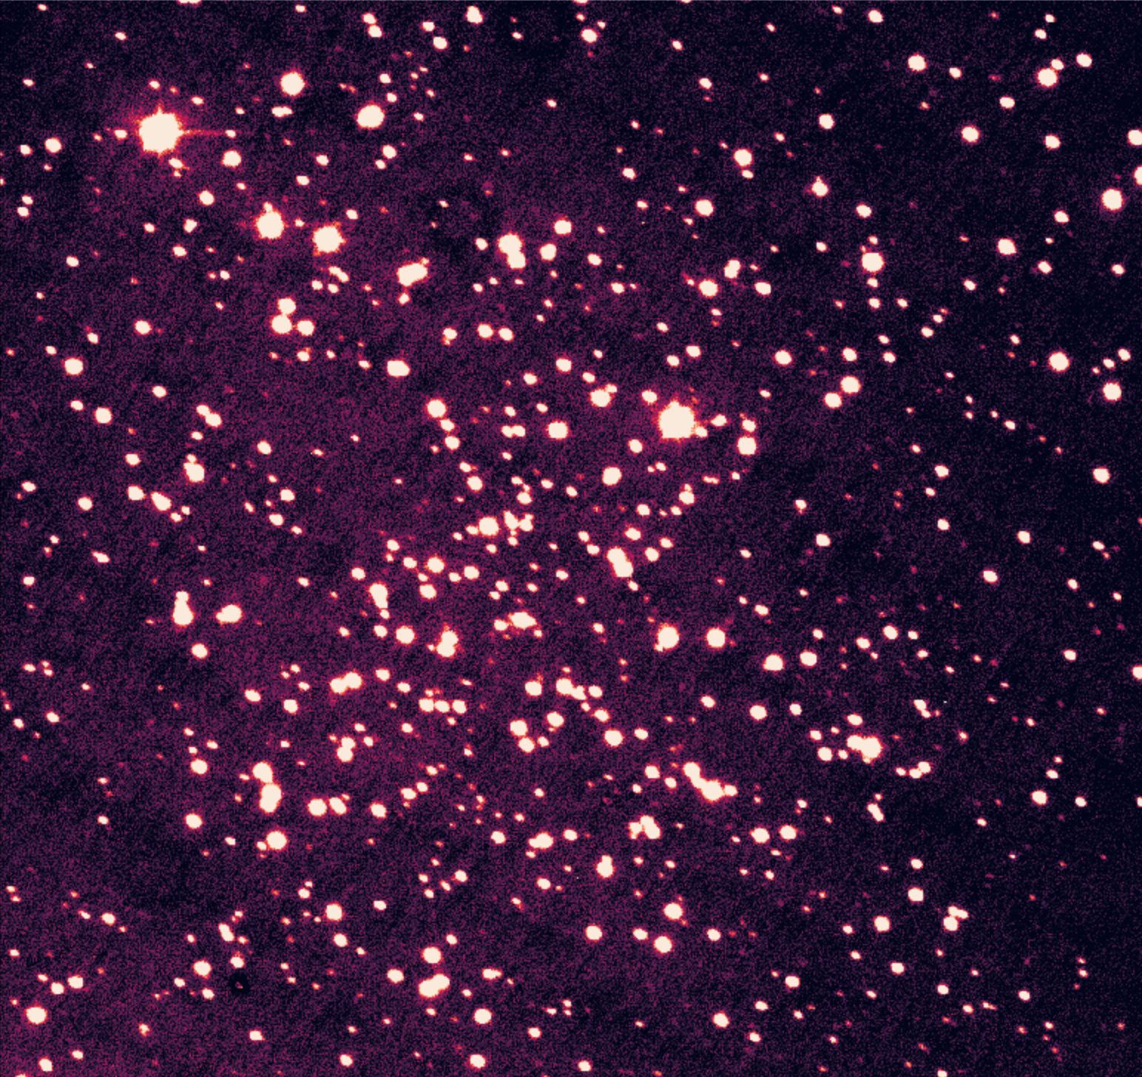
What are Open Cluster?
Berkeley 28
Stellar populations of ⪅ 1000
Most are younger than globular cluster
Loose gravitational bound
High enrichment metallic mainly population I stars
Homogenous populations, makes them ideal to use as galactic laboratories.
NGC 2324

Slide 6
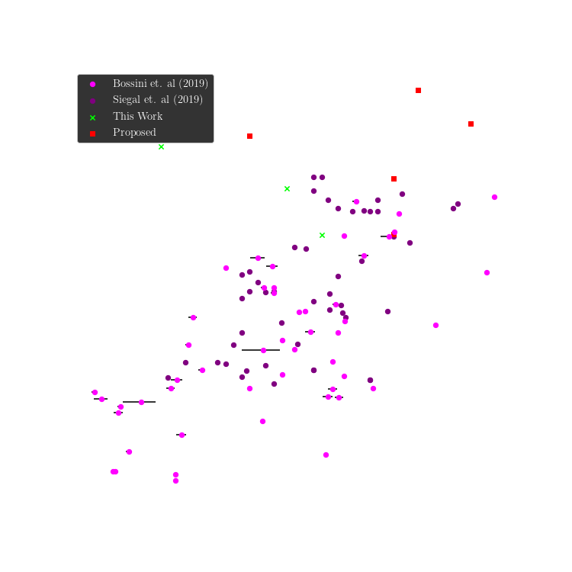
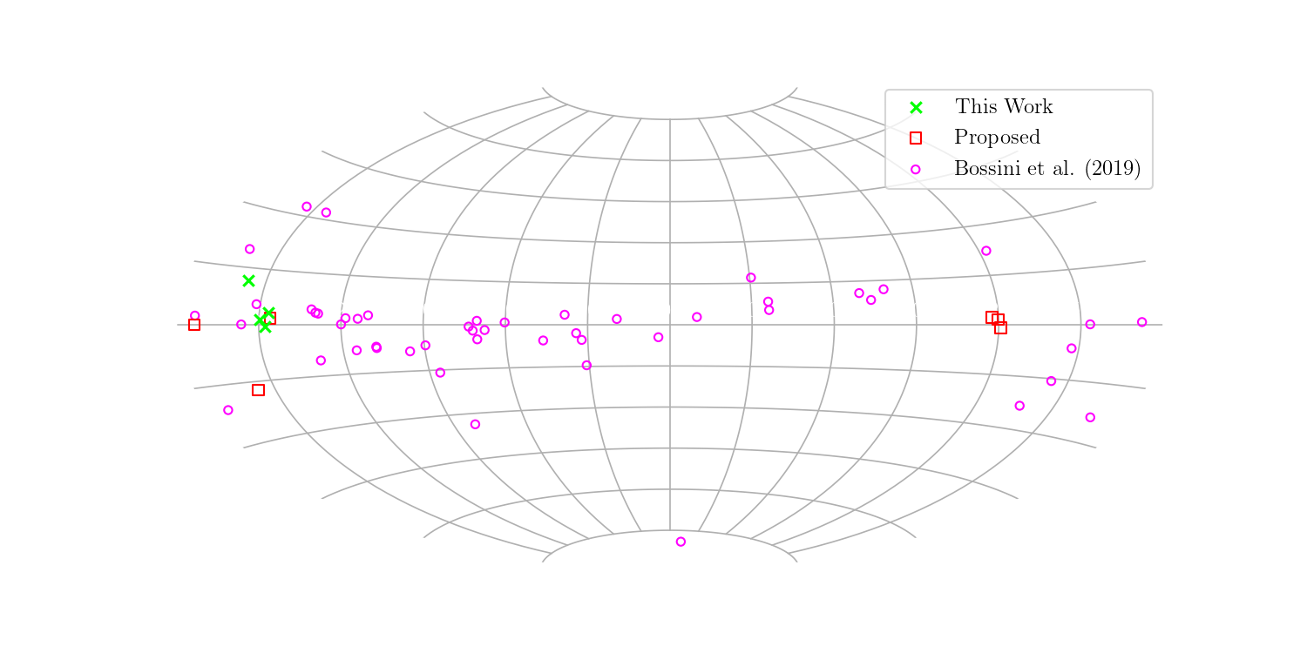
Target & Data Selection Strategy

Slide 7

Determining Cluster Parameters
We’ve now have clusters of interest how do we learn about them?
Through fitting isochrones to colour magnitude diagrams (CMDs)
Isochrone $→$ a curve that can be fitted to a Hertzsprung-Russell (H-R) diagram that details the evolution of stars with specific parameters (age, Fe/H, Av, distance)
CMDs $→$ diagram variant of H-R diagram using magnitude (y-axis) and colour (x-axis)

Slide 8
Obstacles in Fitting Isochrones
Two problems prominent issues in finding cluster parameters
Are the detected stars members of the cluster?
Open-clusters have no discernable shape so spatial distributions go out the window!
The stellar population is homogenous (for the most part)
Thus we turn to how

